Slide 1
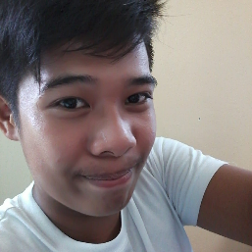
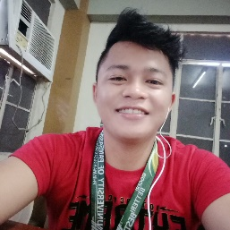

Reminder App
Mark Anthony Siapno
Jeffrey De Guzman
Carl Jamel Castañares
GROUP SDC
DATE OF PRESENTATION:
January 16, 2021
3:15 PM – 3:30 PM

Slide 2
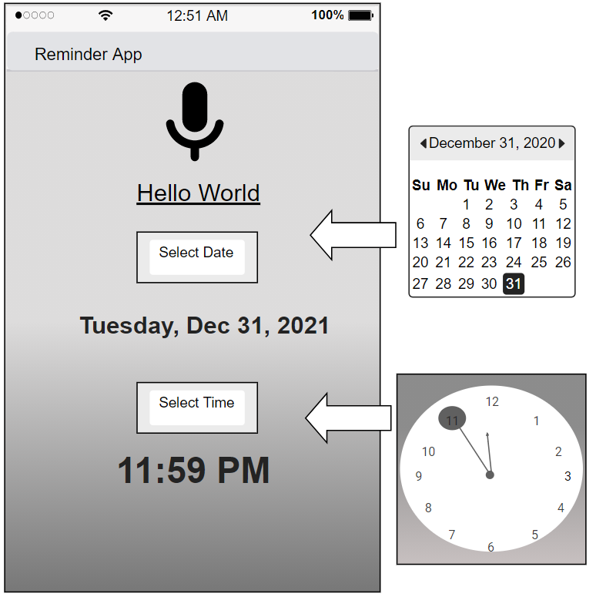
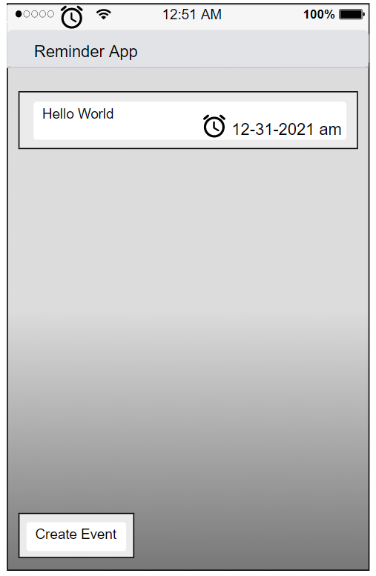
Introduction
Thank you for the opportunity to submit a proposal for our Reminder mobile app. Working together, we believe we can create a mobile app that is simple to navigate and has a professional yet welcoming design.
Based on our preliminary discussion of our team, we have identified and listed below the Needs and Solutions that we will want to address in this project.

Slide 3
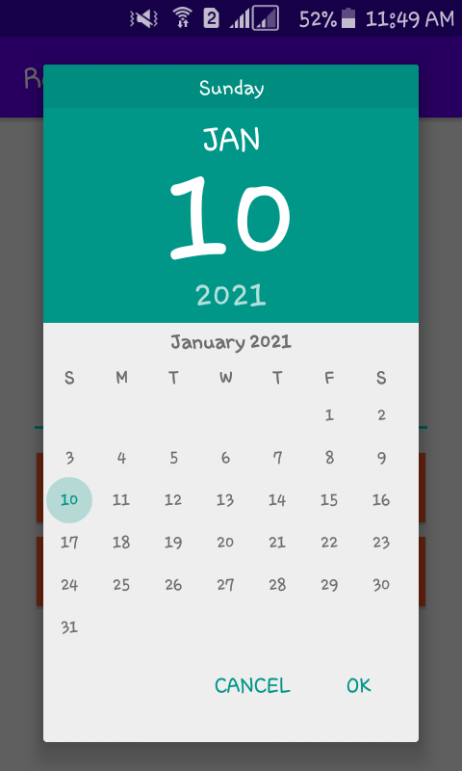
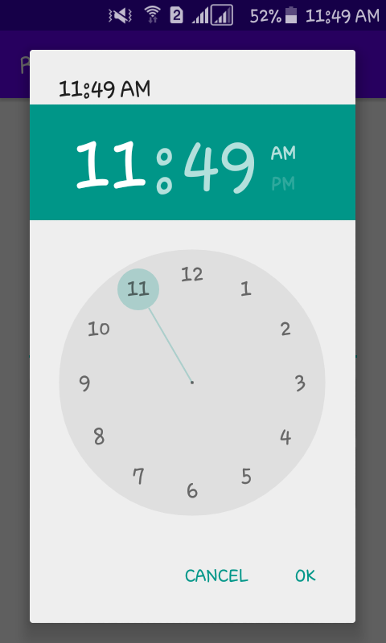
Needs
SDC Company needs a mobile application to reach out to the community and also to serve and support the current SDC Company clients.
SDC Reminder app is a user friendly interface that consists of selecting a time and date to start a reminder event. This mobile app would make a good benefit for those who needs their time to be managed.

Slide 4
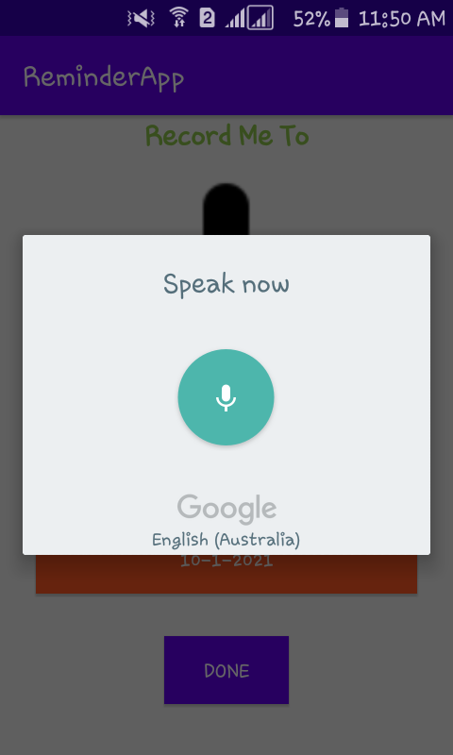
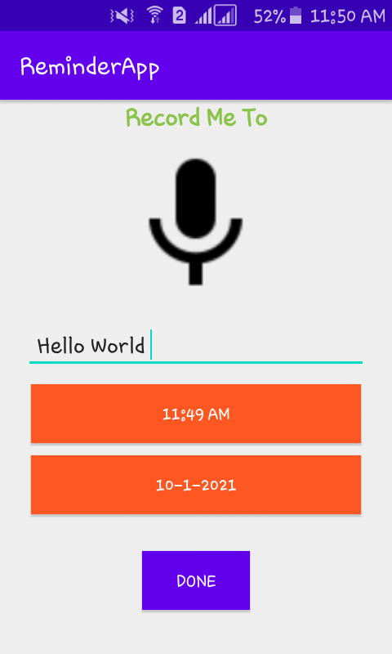
Solutions
Reminder App will provide SDC Company with a fresh new mobile application that is easy to navigate and provides useful information to current subscribers. The design will also convey to potential subscribers that SDC Company is a professional, reliable company. The design will not change so it will maintain a familiar look to current subscribers, but will at the same time show them that SDC Company is improving its mobile application presence in order to serve them better.

Slide 5
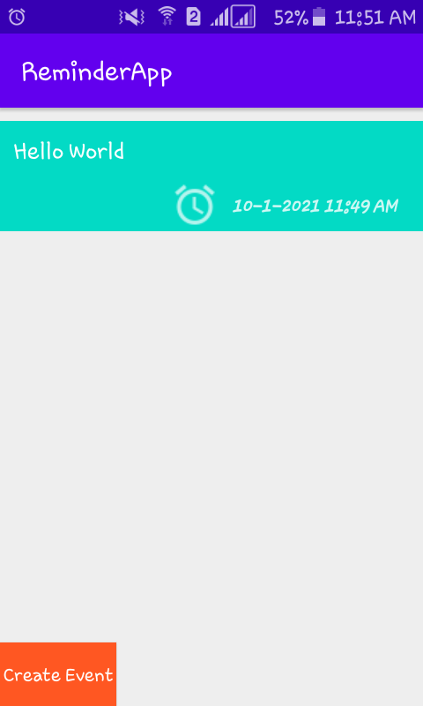
Content Management System (IN the future needs)
Central to the new design from Reminder App will be a robust Content Management System (CMS) that will allow SDC Company to make changes easily to the mobile application, without requiring a dedicated workstation or additional software.
SDC Company will not stop to make our system great and to make our clients satisfied.

Slide 6
MOBILE APP Organization
The design will have three main mobile features:
Sign-up and login Onboarding splash screen Navigation Image galleries
Forms Social media integration Social Feeds Product menus
Shopping carts and payments Loyalty cards Booking systems Calendar integrations
Push notifications Native video Native maps Device hardware access App analytics
These main features will be hardwired into the new design by our Reminder App.
These will be the main features of our mobile app, SDC Company will make sure to provide our users the best quality of our mobile app.

Slide 7
Preliminary Design
Working in conjunction with SDC Company, Reminder App will provide SDC Company with a preliminary design concept for the new mobile application. That design concept will include the basic layout, color palette, etc. SDC Company can run at any android/ios device, this mobile app wouldn’t be a hassle to get. We also make sure that every content of this app would be free.

Slide 8
Training
Reminder App will then run a two-hour training session with SDC Company employees. This can be done on site or online.
SDC Company will always look into improving the mobile app to make sure all clients/user will have a good experience.

Slide 9
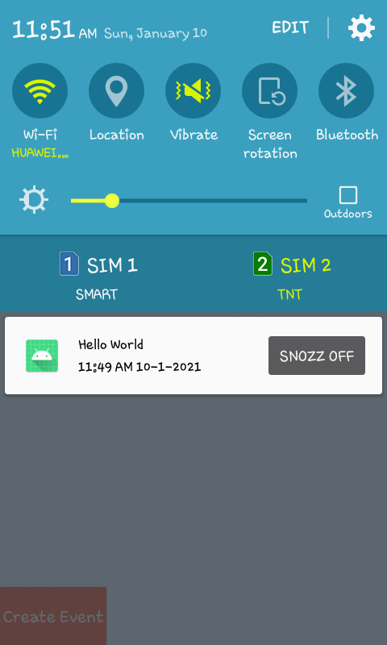
Launch
When SDC Company has finished incorporating all the content they wish to have at launch, they will ask Reminder App to move the mobile application from the development sub-directory to the main root level of the uploaded apk file over google apps, thereby making the mobile app go live. Congratulations!

